Slide 1
Outline of Today’s Discussion
The Distribution of Means (DOM)
Hypothesis Testing With The DOM
Estimation & Confidence Intervals
Confidence Intervals on Excel Graphs
The Central Limit Theorem

Slide 2
Part 1
The Distribution of Means

Slide 3
The Distribution of Means
The distribution of means is
A distribution of the means of a large number of samples of the same size
Each sample randomly selected from the same population of individuals

Slide 4
Characteristics of the Distribution of Means
Mean
Same as the mean of the population of individuals
Variance
Variance of the population of individuals divided by the number of individuals in each sample
SD of the distribution of means is the square root of the variance of the distribution of means
Shape
Approximately normal if either
Each sample as at least 30 observations
Underlying distribution of the population of individuals is normal
In general, unimodal, symmetrical, less spread out than the distribution of the population of individuals

Slide 5
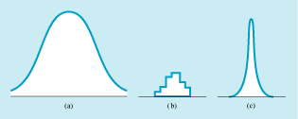
Review of Three Kinds of Distributions
We’ve considered three kinds of distributions
The distribution of the population of individuals
The distribution of a sample
The distribution of means of samples

Slide 6
Main Points on the D.O.M
The standard deviation describes the average extent to which a RAW SCORE (that’s one raw score) deviates from the mean of the distribution of raw scores.
The standard error describes the average extent to which a SAMPLE MEAN (that’s the mean of one sample) deviates from the mean of the distribution of means (DOM).

Slide 7
Main Points on the D.O.M
Q: Why would we want to use the standard deviation of the D.O.M.?
A: So we can put a mean in context!
This is similar to the rationale for knowing the SD of a distribution of raw scores…whether we have a raw score or a mean we want some CONTEXT.

Slide 8
Main Points on the D.O.M
Example: Your new drug is given to a sample of depressed patients. Subsequently, the sample’s mean mood score is 25, whereas the mean for the population of all depressed people is 20.
Did our drug have a significant effect?
IT DEPENDS!!!!
If the D.O.M has a standard deviation of 10 units, then our sample is not so different from the D.O.M. mean. Our drug isn’t so special.
If the D.O.M. has a standard deviation of 1 unit, then our sample mean is very different from the D.O.M. mean. Our drug is hot stuff!!!

Slide 9
Main Points on the D.O.M
The standard error IS the standard deviation of the distribution of means (DOM).
We can estimate the standard deviation of the DOM from a sample. To do so, we use the equation S.E. = SD_{sample} / sqrt( n ).
The mathematical reasons (the proofs for) why the sample’s SE constitute the best estimate of the DOM’s SD are beyond this course.

Slide 10
Main Points on the D.O.M
Two main factors influencing the SD of the DOM. (Two factors influence DOM’s “fatness”.)
First, the SD of the raw score distribution.
Second, the sample size.
Let’s consider each in turn…

Slide 11
Main Points on the D.O.M
The SD of the raw score distribution is directly related to the SD of the DOM.
“Fatter” raw score distributions tend to generate “fatter” DOMs. (“Fatter” means more variable)
“Thinner” raw score distributions tend to generate “thinner” DOMs. (“Thinner” means less variable)

Slide 12
Main Points on the D.O.M
The sample size is inversely related to the SD of the DOM.
As the sample size increases, the SD of the DOM shrinks. (Becomes less variable)
Why? Let’s recall the equation for the SD of the DOM, which is the sample’s SE: S.E. = SD_{sample} / sqrt( n ). Other intuitions?

Slide 13
Main Points on the D.O.M
It is mathematically possible to estimate a population mean from a sample mean…and the DOM can help us with this estimation.
The reason is that the DOM has a mathematical relation to the sample, and also to the population…

Slide 14
Main Points on the D.O.M
From a sample in our drug study, we can compute a mean, SD, and SE.
The SE from our sample is the best estimate of the DOM’s SD.
DOM Variance = DOM SD²
There is a mathematical relation between the DOM variance and the population variance. Population Variance = DOM Variance * N (see page 161, rule 2a ) (N = sample size)
With this estimate of the Population Variance, we can take the square root to get the estimated SD of the population!

Slide 15
Part 2
Hypothesis Testing
With The DOM

Slide 16
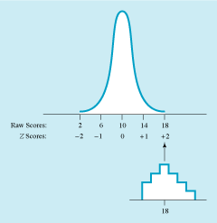
Hypothesis Testing with a Distribution of Means
Figuring Z score of a sample’s mean on the distribution of means
Conceptually the same as figuring a Z score for an individual on a distribution of a population
Subtract the mean of the distribution of means from the sample’s mean
Then divide by the SD of the distribution of means

Slide 17
Review of Z-Scores
Z-scores are important because they allow us to evaluate relative values…even across seemingly unrelated phenomenon.
Example: Assuming a bell shaped distribution, if your z-score = +1, your at the 84th percentile.
This is true whether we are talking about personality traits, physical attractiveness, shoe size, or intelligence…or anything else!

Slide 18
Review of Z-Scores
For any bell shaped distrubion, z-scores inform us about…
Percentile rank (% of scores at or below your score).
The percent of scores “beyond” your z-score (i.e., further away from the mean than your score).
The percentage of scores falling between two points on the distribution.
The relative likelihood of your score. Z-scores are less and less likely as they depart from zero.

Slide 19
Review of Z-Scores
In short, Z-scores tell us where a score falls in a distribution of scores…
They also tell us where a mean falls in a distribution of means (DOM)
Consequently, z-scores are essential for hypothesis testing, which is based on sample means (RIGHT?)

Slide 20
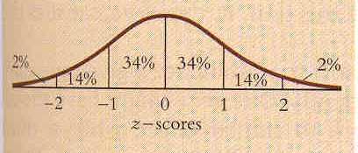
The Normal Distribution
The most extreme 5% of scores (2.5% on either side)
are said to be “significantly different”
from the mean.

Slide 21
The Normal Distribution
This is true whether the distribution is filled with
raw scores or filled with means!
That is, the same rules apply to the DOM.

Slide 22
One-tailed vs. Two-tailed Hypothesis Tests
Directional prediction
Researcher expects experimental procedure to have an effect in a particular direction
One-tailed significance tests may be used
Nondirectional prediction
Research expects experimental procedure to have an effect but does not predict a particular direction
Two-tailed significance test appropriate
Takes into account that the sample could be extreme at either tail of the comparison distribution

Slide 23
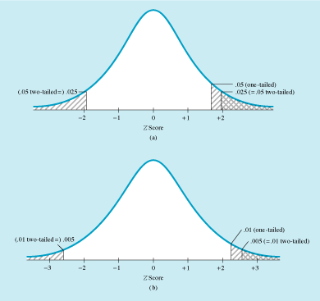
Significance Level Cutoffs for One- and Two-Tailed Tests
The .05 significance level
The .01 significance level

Slide 24
One-tailed vs. Two-tailed Hypothesis Tests
Two-tailed tests
More conservative than one-tailed tests
Some believe that two-tailed tests should always be used, even when an experimenter makes a directional prediction

Slide 25
Review of Z-Scores
Will someone remind us what an alpha level is?
I’d like you to memorize some extremely important Z-scores.
First: Z = 1.64 (used for 1-tailed tests when Alpha = 0.05)
Second: Z = 1.96 (used for 2-tailed tests when Alpha = 0.05)
Third: Z = 2.58 (used for 2-tailed tests when Alpha = 0.01)

Slide 26
Review of Z-Scores
For a one-tailed test and alpha level =0.05, statistical significance occurs 1.64 z-scores away from the mean.
That is, only 5% of scores on ONE SIDE
of the distribution are further than 1.64 z-scores.

Slide 27
Review of Z-Scores
For a two-tailed test and alpha level =0.05, statistical significance occurs 1.96 z-scores away from the mean.
That is, only 5% of scores on EITERH SIDE
of the distribution are further than 1.96 z-scores.
2.5% right side + 2.5% left side = 5% total

Slide 28
Review of Z-Scores
For a two-tailed test and alpha level =0.01, statistical significance occurs 2.58 z-scores away from the mean.
That is, only 1% of scores on EITHER SIDE
of the distribution are further than 2.58 z-scores.
.5% right side + .5% left side = 1% total

Slide 29
Review of Z-Scores
Potential Pop Quiz Question: What percentage of
scores fall between +1.64 z-scores from the mean?

Slide 30
Review of Z-Scores
Potential Pop Quiz Question: what percentage of
scores fall between +1.96 z-scores from the mean?

Slide 31
Review of Z-Scores
Potential Pop Quiz Question: What percentage of
scores fall between +2.58 z-scores from the mean?

Slide 32
Part 3
Estimation
&
Confidence Intervals

Slide 33
Confidence Intervals
Very often, psychologists must make estimates!
Examples: Estimating the population of smokers, given a sample of smokers.
Two types of estimates are often distinguished: Point estimates and Interval estimates.

Slide 34
Confidence Intervals
Confidence intervals sometimes used instead of, or alongside, ordinary hypothesis testing
If confidence interval does not include the mean of the null hypothesis distribution, result is statistically significant
Rare for researchers to know the characteristics of the population distribution, but when they do, the hypothesis test that is appropriate is a Z test.

Slide 35
Confidence Intervals
Point Estimate – An approximation of a single value (i.e., a point…usually the mean) within a distribution.
Example: Estimating the mean weight of the Denison student population.
That mean weight would be a single number, i.e., a single point…

Slide 36
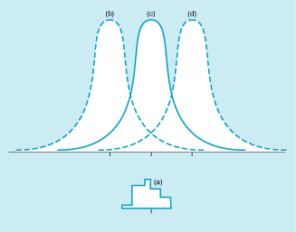
Confidence Intervals
Point estimate
Estimate of a specific value of a population parameter (e.g., the mean)
The best estimate of the mean of a population is the mean of a sample taken from that population
SD of the distribution of means (called the “standard error”) is a measure of the accuracy of the point estimate

Slide 37
Confidence Intervals
Interval Estimate – An approximation of a specified range (i.e., an interval) within a distribution. (The range has an upper bound and a lower bound.)
Confidence Interval – an interval estimate that is based on considering a specified level of risk, expressed in percents.
Example: For Denison Students, the 95% confidence intervals for weight might extend from 125 to 165 pounds.
That is, “we are 95% confident that the mean weight for the Denison population is between 125 and 165 pounds”.

Slide 38
Confidence Intervals
Potential Pop Quiz Question: Is there a direct or an inverse relationship between the confidence level (i.e., 95% confidence, versus 99% confidence), and the confidence interval? Explain.

Slide 39
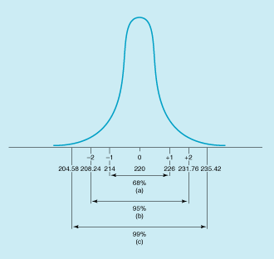
Confidence Intervals
Confidence interval
Interval estimate with a given likelihood of including the population mean
Typical confidence intervals
95%
99%
The larger the interval, the greater one’s confidence that the interval contains the true mean

Slide 40
Confidence Intervals
The upper and lower boundaries of our confidence interval need to be specified in the same unit of measure used for the mean.
Computing confidence intervals requires using z-scores….

Slide 41
Confidence Intervals
When our data graphs contain an error bar equal to +1 S.E.,
we are essentially saying “…we are 68% confident
that the population mean falls within these boundaries”.
Could someone explain why?

Slide 42
The Normal Distribution
68% of the scores fall between +1 SD.

Slide 43
Confidence Intervals
When our data graphs contain an error bar equal to +1.96 S.E.,
we are essentially saying “…we are 95% confident
that the population mean falls within these boundaries”.
Could someone explain why?

Slide 44
Confidence Intervals
When our data graphs contain an error bar equal to +2.57 S.E.,
we are essentially saying “…we are 99% confident
that the population mean falls within these boundaries”.
Could someone explain why?

Slide 45
Steps for Figuring 95% and 99% Confidence Intervals
Estimate population
Best estimate is sample mean
Figure SD of distribution of means
Find Z scores that go with confidence limits you want
For 95%, Z scores are +1.96 and -1.96
For 99%, Z scores are +2.57 and - 2.57
Convert Z scores to raw scores
Multiply Z score by SD of distribution of means and add to the population mean

Slide 46
Part 4
Confidence Intervals
On
Excel Graphs

Slide 47
Part 5
Central Limit Theorem

Slide 48
Central Limit Theorem
Central limit theorem – For any population with a mean (M) and a standard deviation (SD), the distribution of means (DOM) for sample size n will approach a normal distribution with a mean of M and an SD = PopulationSD / Sqrt(n)
For samples of n=30 or more, the DOM will be almost perfectly normal.

Slide 49
Central Limit Theorem
In Class Exercise
Use the rand() command in excel to generate 100 random numbers from 0 and 100.
Do this for columns A, B, and C, then take the rounded mean of each column.
Round(average(a1:a100), 0)
Remember that the rand() command is based on a
rectangular distribution…but we’ll build a distribution of means
and evaluate its shape

